Slide 1


P6 Stanford
Amine Fatmi, 16/02/2021

Slide 2
Scope of work
The aim of this project is to build a deep learning model for image classification using the Stanford dog dataset (120 breeds).
More precisely, we will be using Convolutional Neural Networks (CNN) as they are robust for image classification.
CNN model from scratch
Pre-trained models using Transfer Learning

Slide 3
Contents
Stanford Dog dataset
Preprocessing + CNN
CNN from scratch (10 breeds)
Transfer Learning (10 breeds)
Transfert Learning (120 breeds)
Conclusions

Slide 4
Dataset
1
Let’s start by exploring the dataset

Slide 5
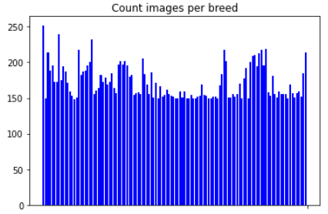
Dataset summary
Stanford dog dataset
120 breeds
Between 148 and 252 images per class
20580 images
Balanced dataset

Slide 6
Preprocessing & CNN structure
1
Let’s start by exploring the dataset

Slide 7
Preprocessing
Rescale dividing by 255.
Reshape images (ex: 150*150)
Whithening and equalization
Data augmentation: increase number of images using transformations.

Slide 8
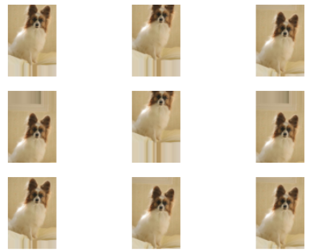
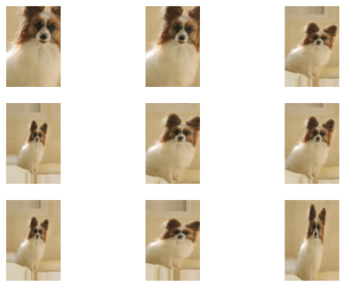
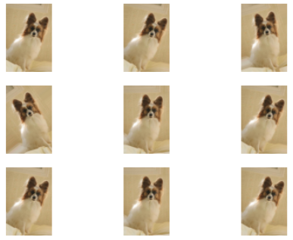
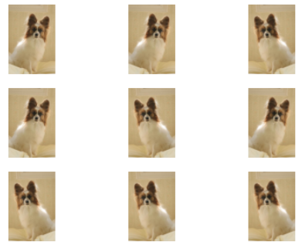
Data augmentation
Height shift
Zoom
Rotation
Flip

Slide 9
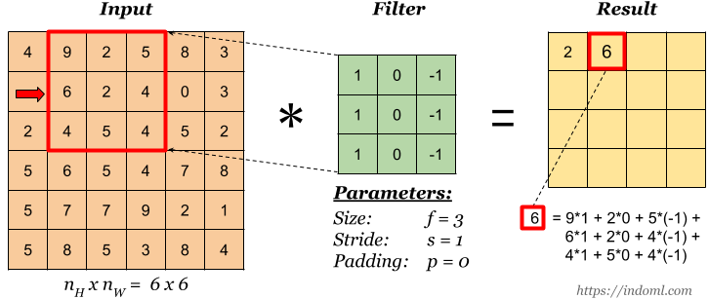
CNN: convolution

Slide 10
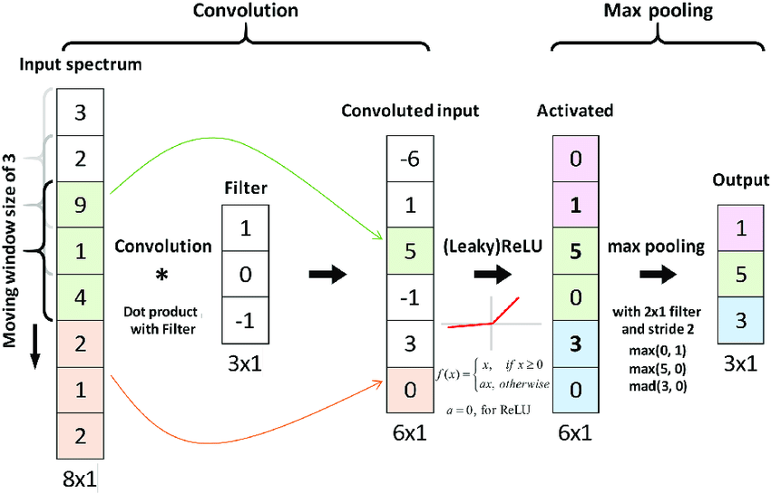
CNN principle

Slide 11
Batch normalization
Normalize output from activation function:
z = (x – m) / s
Multiply normalized by arbitrary parameter g:
z * g
Add arbitrary parameter b
(z * g) + b

Slide 12
Batchnorm - benefits
m, s, g and b parameters are all trainable
Weights within network do not become imbalanced since normalization is included in the Gradient process.
Regularization: avoid outline large weights which would influence the learning process and cause instability (propagate through layers)
Speed up the learning process and reduce computational time

Slide 13
CNN from scratch
2

Slide 14
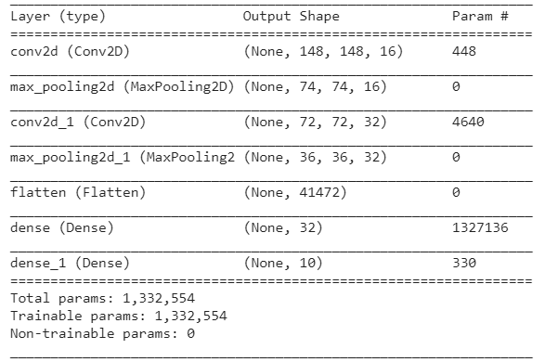
CNN baseline model (10 breeds)
= 16 * (3 *3) * 3 + 16
= 32 * (3 *3) * 16 + 32
= 41472 * 32 + 32

Slide 15
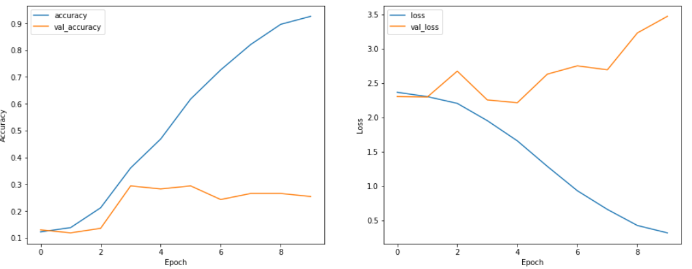
CNN baseline model (10 breeds)
Test_set_accuracy = 0.23

Slide 16
CNN iterations (10 breeds)
Data augmentation: increase number of images by applying random transformations
Zoom, shift, flip, rotation,…
Add dropout layer: regularization technique by activating only a proportion of neurons
Batch normalization: normalize output of activation layer
Regularization + speed
Add Conv2D layer
Test different values (dropout, dense layer neurons, batch size, …)

Slide 17
CNN results (10 breeds)
CNN scratch | Baseline | Baseline + data augmentation | Baseline + DA + dropout + Conv2D
Accuracy | 0.23 | 0.36 | 0.37
Loss | 3.17 | 2.22 | 1.87
~1500 images for 10 breeds
~ 1 300 000 trainable parameters (baseline)
Data augmentation is the main source of improvement for the CNN from scratch.

Slide 18
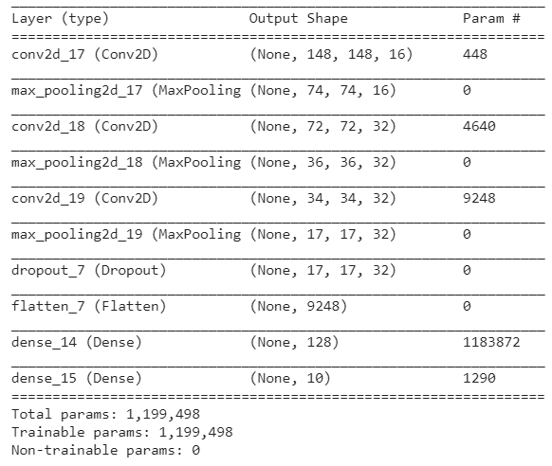
CNN best model (10 breeds)
Data augmentation
3 * Conv2D
Dropout (0.5)
Dense (128)

Slide 19
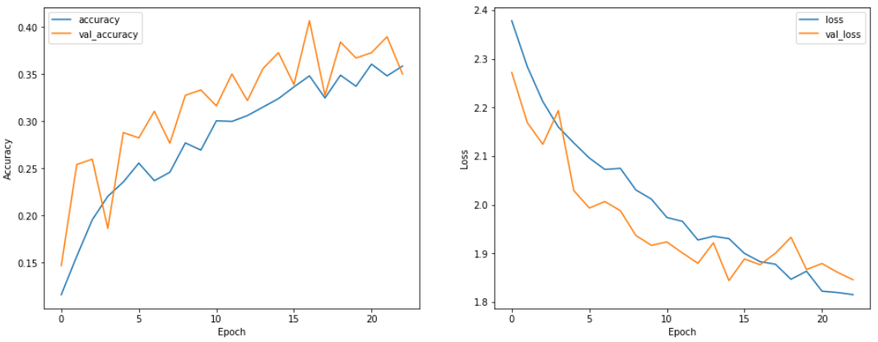
CNN baseline model (10 breeds)
Test_set_accuracy = 0.37

Slide 20
Transfer Learning 10 breeds
2

Slide 21
Transfer Learning
Use pre-trained models on large number of images (ex: ImageNet)
VGG16, Inception_V3, Xception
Freeze base layers (weights already optimized)
Remove pre-trained classification layer and add classification layer to fit the current task
Fine-tuning: unfreeze part or all base layers with a small learning rate
Generally lead to significant improvement

Slide 22
Process (10 breeds)
Step 1
Step 2
Step 3
Step 4
Compare pre-trained baseline models
Hyperparameter tuning
Fine-tuning best models
Generalization 120 breeds
VGG16
Xception
Inception V3
Flatten vs GAP
SGD vs Adam vs RMSProp
Unfreeze all base layers
Small learning rate: 1e-5
Select best model and hyperparameters and run on 120 class

Slide 23
Model comparison
Model | Xception | VGG16 | Inception V3
Accuracy | 0.93 | 0.56 | 0.94
Loss | 0.90 | 1.63 | 1.26
Significant improvement for all models compare to CNN from scratch
VGG16 less performing pre-trained models
Xception and Inception_V3 are performing well:
Keep these 2 models from now on

Slide 24
Flatten vs GAP
Xception | Flatten (baseline) | With GAP
Accuracy | 0.93 | 0.98
Loss | 0.90 | 0.68
Global Average Pooling gives better results than Flatten
Use GAP from now on

Slide 25
Optimizers
Xception | SGD | Adam | RMSProp
Accuracy | 0.90 | 0.97 | 0.98
Loss | 0.070 | 0.063 | 0.068
epochs | 88 | 17 | 7
All 3 optimizers are doing well. However:
SGD lower accuracy and more epochs required to converge
Adam and RMSProp gives good accuracy and converge faster. Adam is used from now on.

Slide 26
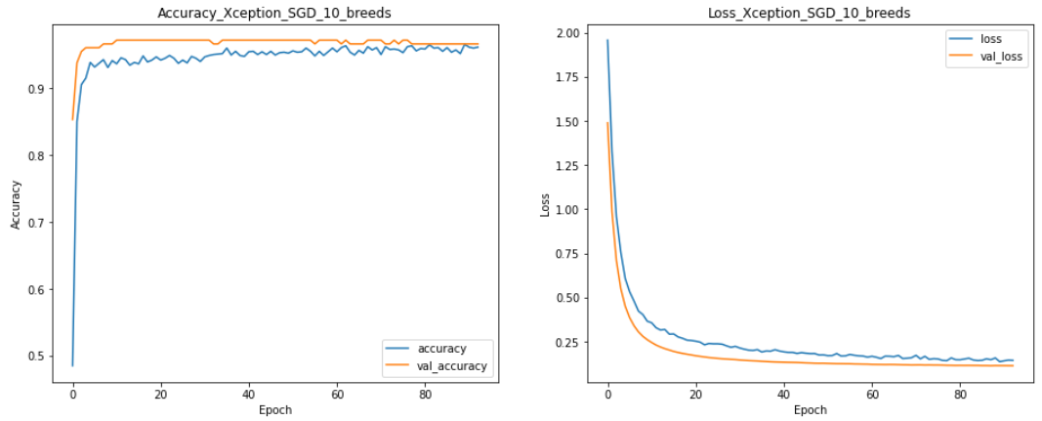
Xception with SGD (10 breeds)
SGD slow convergence.

Slide 27
Model choice for generalization
Inception V3
Adam optimizer
Global Average Pooling
Data augmentation
Add dense layer (128) before classification
Fine-tune; unfreeze base layers and use small learning rate: a = 1 e-5

Slide 28
Fine-tuning 120 breeds
3

Slide 29
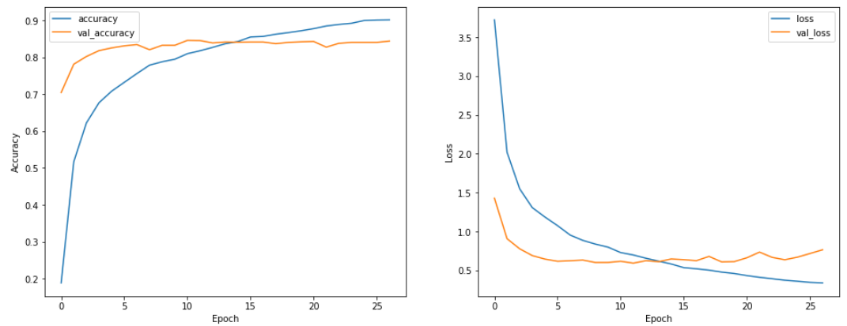
Inception results (120 breeds)
Test_set accuracy = 0.83
Test set loss = 0.63

Slide 30
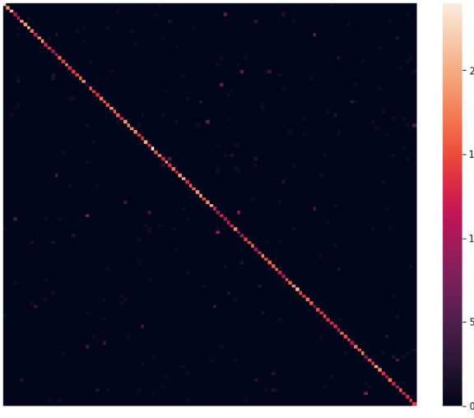
Inception results (120 breeds)
Test_set accuracy = 0.83
Test set loss = 0.63
Nice diagonal
Few points outside the diagonal
Next slides: zoom on these classes.

Slide 31
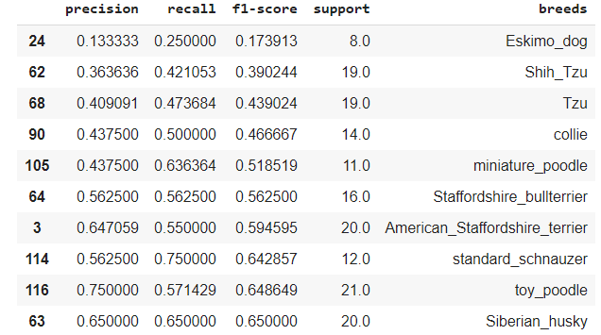
Inception results (120 breeds)
10 breeds with lower performance with respect to f1-score
In the next slides, I will try to explain why the model is failing to classify some of these breeds correctly.

Slide 32
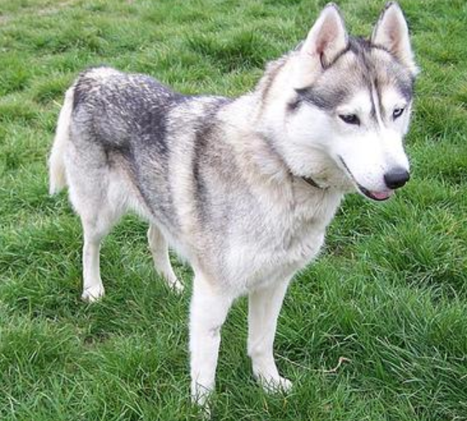
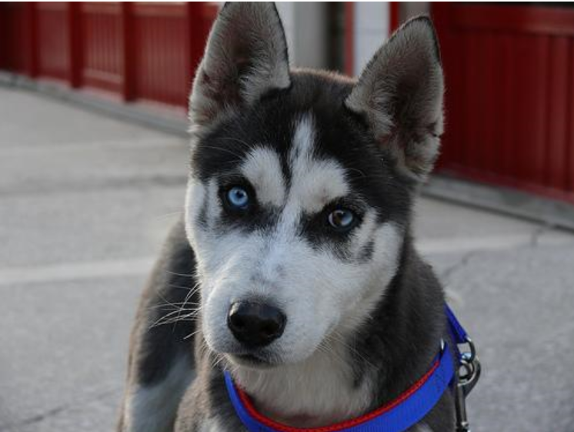
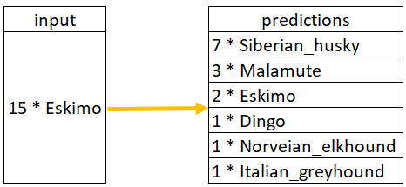
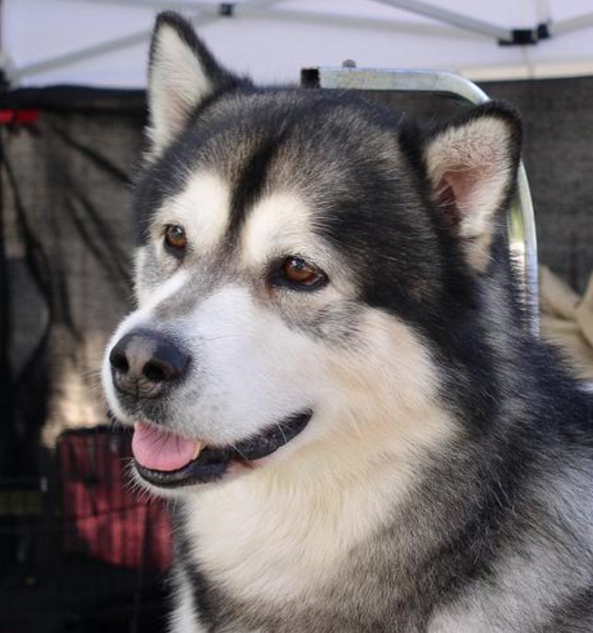
Eskimo predictions
Siberian husky
Eskimo
Malamute

Slide 33
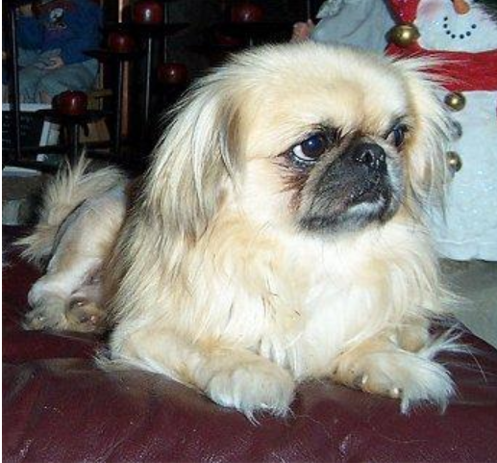
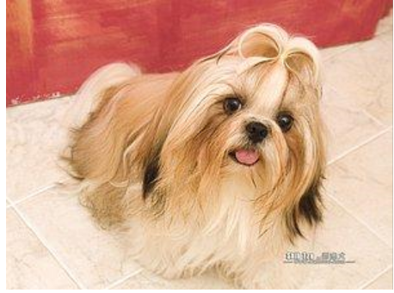
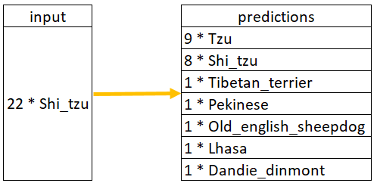
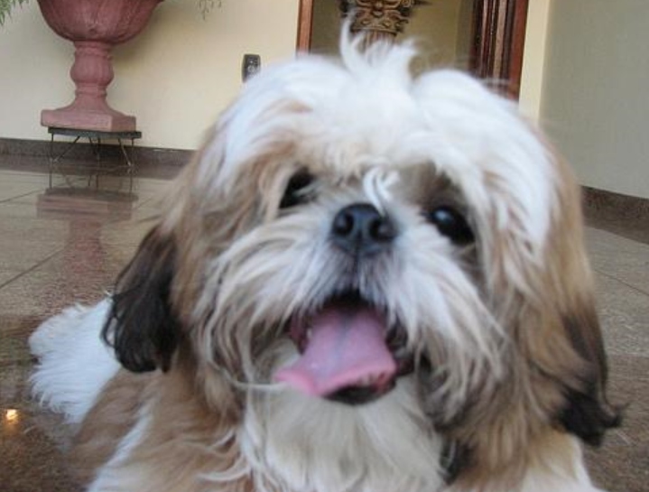
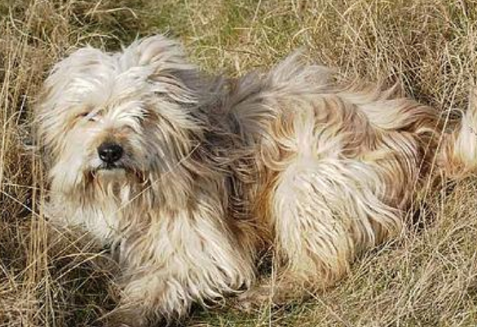
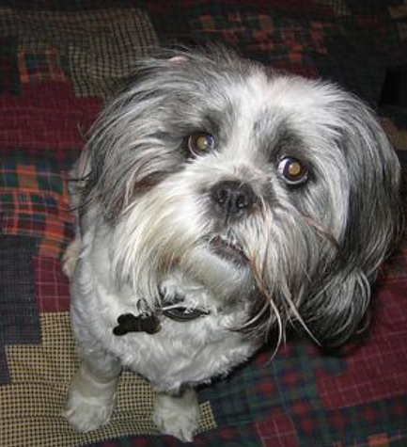
Shi_Tzu predictions
Pekinese
Tibetan terrier
Shi_tzu
Tzu
Lhasa

Slide 34
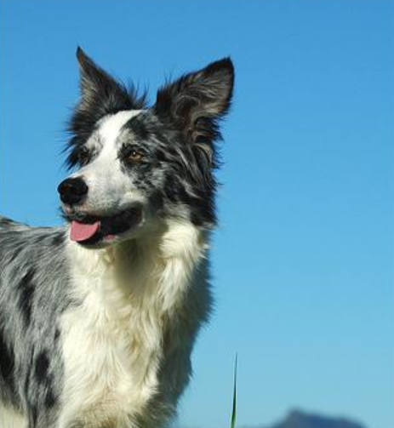
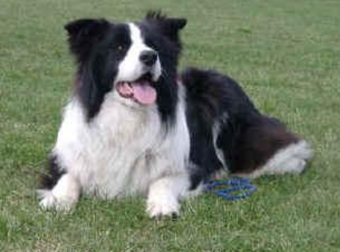
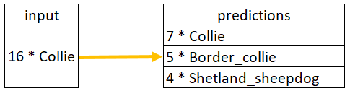
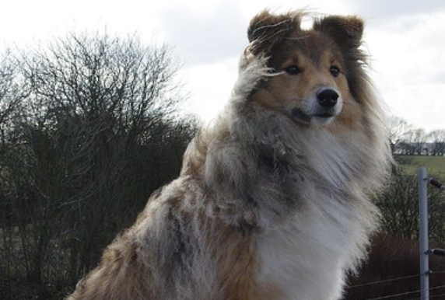
Collie vs Border_collie
Border_collie
Collie
Shetland_sheepdog

Slide 35
Conclusion
Transfer learning is a really powerful technique to transfer knowledge from pre-trained model.
Lead to significant improvements compare to the CNN from scratch.
The final model is quite good at classifying dogs.
The model did make some mistakes but it was mainly with breeds that are really close to each other. Even a human could have missclassified them.
CNN models are highly performing on image classification tasks.

Slide 36
THANKS!
Any questions?

